Slide 1

Human resources slide 1
Flexible, Biocompatible, and Wirelessly Powered Implantable Optoelectronics

Slide 2
1. Current Achievements
Circuit
Tested and working for frequencies below 20MHz.
Miniaturised:
NCP161 with small package (not flip chip)
Schottky diode 0204 sized
Using LED: WE White light → We can change it later for the TR2227 CREE LED that have the same specifications than the used led
Antenna
Designed an antenna with the following parameters
Number of turns = 5
wire width = 0.5 mm
Spacing = 0.5 mm
Outer Diameter = 22.2 mm
Inner Diameter = 12.3 mm

Slide 3
2. Next things I need to focus on
Prepare last version of the circuit
Possible improvement of the signal stability
There are several artefacts that could blur the input of the LED.
Add 1pF capacitor before and after the LDO to reduce the voltage dropout and increase the WPT efficiency.
Prepare Testing Phase
Review some bibliography to find which tests I need to run for the device.
Prepare pictures for the publication
Prepare the conference paper before 5th of July.

Slide 4
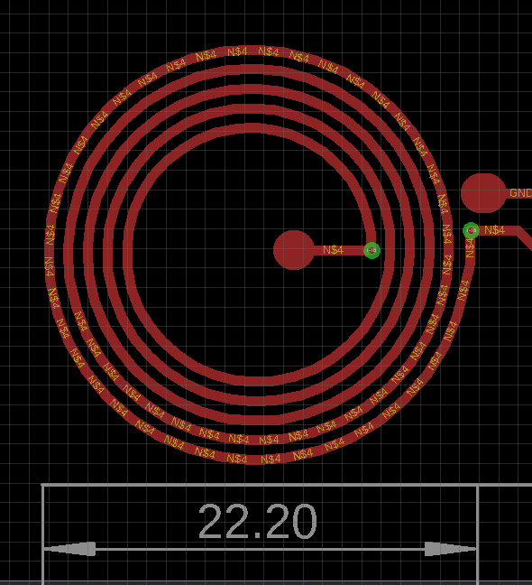

Pictures
Matching Capacitor
Next step→ Tuning!!

Slide 5
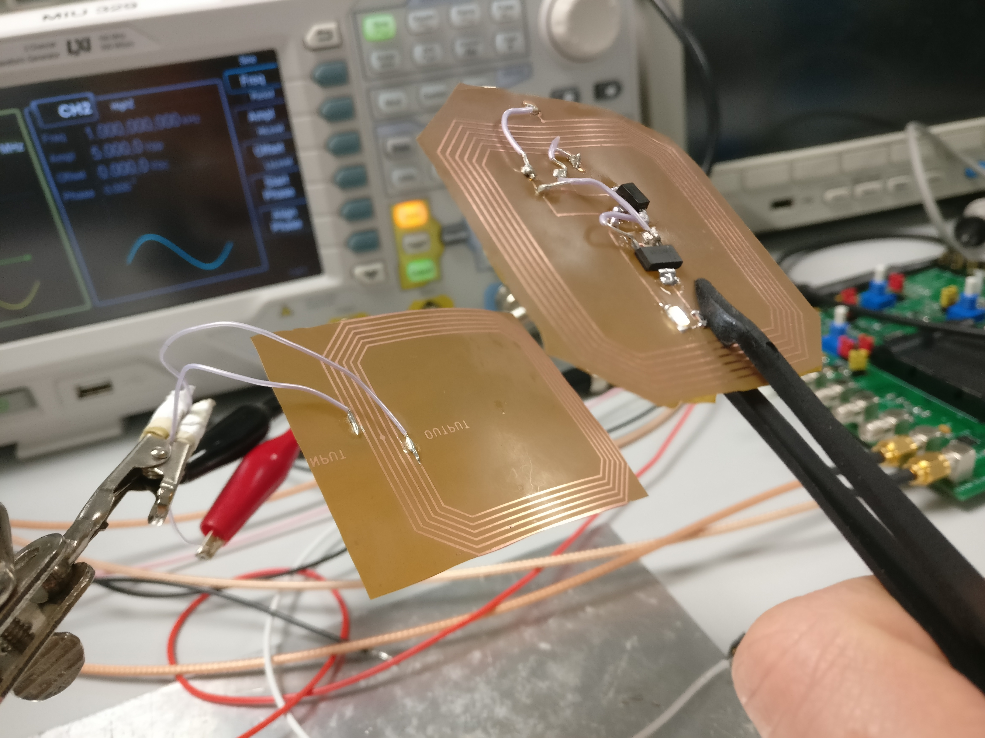
Pictures

Slide 6
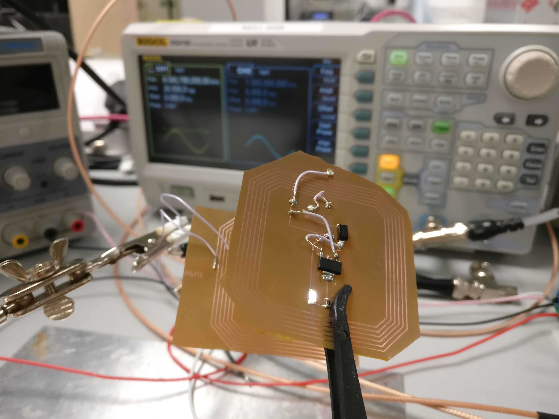
Pictures
Resonant around 8 MHz and 10 Vpp (5 Volts amplitude)

